Slide 1
Topic: Division with array EQ: How do I apply the division with array strategy?
Year 11 Essentials

Slide 2
Things Required For This Lesson
Interactive Notebook
Textbook: Interleaved Maths Essential Connections
Ruler, Red Pen, Pencil, Pens, Scientific Calculator
Growth mindset

Slide 3

24
7
30
Topic: Division with array
Date: 12/02/2021
EQ: How do I apply the division with array strategy?
WICOR
This Photo by Unknown Author is licensed under CC BY-SA

Slide 4
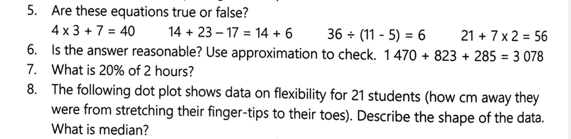
Topic: Division with array
EQ: How do I apply the division with array strategy?

Slide 5

24
7
30
Topic: Division with arrays
EQ: How do I apply the division with array strategy?
Difference between a row and column?
A row is horizontal and moves from left to right
A column goes up and down (vertical)
WICOR

Slide 6
24
7
30
Topic: Division with arrays
EQ: How do I apply the division with array strategy?
What is division?
Division can be thought of making arrays when you know the total amount of squares and the number of rows, and you have to find the missing number of columns.
4
4
3
12
3
12
WICOR

Slide 7


24
7
30
Topic: Division with arrays
EQ: How do I apply the division with array strategy?
Divisor – tells you how many needs to be in each group
How do I apply the division array strategy?
$$8÷2=$$
Quotient
Dividend
So you have divided 8 into columns of 2. To get the quotient you count the number of columns.
$$8÷2=4$$
WICOR

Slide 8

Practice: Use the division array strategy (LHS)
$24÷4=$
$36÷6=$
$15÷3=$
$20÷5=$

Slide 9


24
7
30
Topic: Division with arrays
EQ: How do I apply the division with array strategy?
Divisor – tells you how many needs to be in each group
What to do when the divisor is not a factor of the dividend
$$8÷3=$$
Quotient
Dividend
Count the number of columns for the quotient. There needs to be 3 in each column. 2
How many are remaining? 2
$$8÷3=2 r 2$$
WICOR

Slide 10

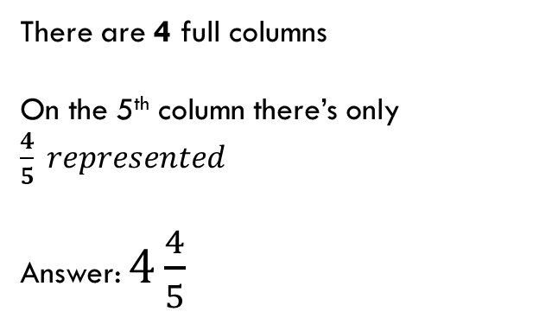
24
7
30
Topic: Division with arrays
EQ: How do I apply the division with array strategy?
Divisor – tells you how many needs to be in each group
How to form a fraction?
$$24÷5=$$
Quotient
Dividend
There are 4 full columns
On the 5th column there’s only $\frac{4}{5} represented$
Answer: $4\frac{4}{5}$
WICOR

Slide 11
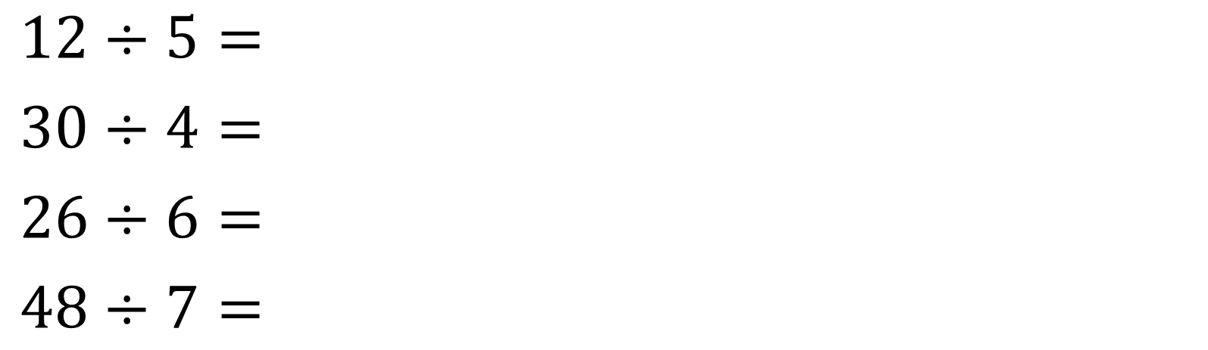
Practice: Use the division array strategy (LHS) Represent the answer as fractions and reminders
$12÷5=$
$30÷4=$
$26÷6=$
$48÷7=$

Slide 12
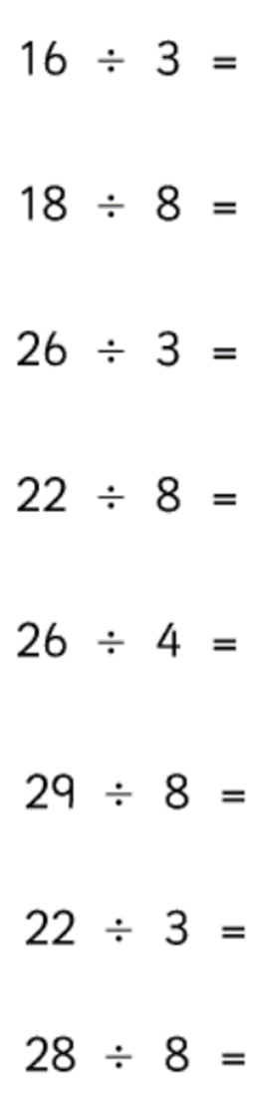
Practice (LHS)
Solve these by drawing the division array. You may need grid paper

Slide 13

Thank you
Keep up the good work!
"Happiness can be found, even in the darkest of times, if one only remembers to turn on the light."

